Slide 1

Agentic AI Hackathon 2025
Date : 06th Feb 2025
Team Name:
AI Enthusiast
Team details :[KGSI DnA]
Abhishek Kumar Gupta(SPOC)
Deepak Chaubey
Mohit Pradhan
Puneeth B K
Notes:
Our team, AI Enthusiast, is excited to showcase our innovative ideas. Each member brings unique expertise: Abhishek Kumar Gupta as the SPOC, Deepak Chaubey leading data governance, and our data engineers, Mohit Pradhan and Puneeth B K. Together, we aim to leverage AI to tackle real-world challenges. The backdrop of code symbolizes our tech-driven approach, setting the stage for a transformative experience in AI development.

Slide 2
Challenges, Business Impact, and Relevance
Industry Challenges
Problem Statement:
Traditional predictive maintenance methods are hindered by downtime, high costs, inaccurate predictions, data inconsistency, safety risks, and regulatory challenges in complex industrial environments, limited support for end-to end solution in real-time.
Goal: Empower businesses with AI-driven predictive maintenance to enhance operational efficiency and reliability by detecting potential equipment failures & recommending actionable.
Key Value Drivers
Enhancing operational efficiency and equipment reliability.
Anticipating and preventing equipment failures before they occur.
Receiving actionable recommendations for maintenance and repair.
Achieving accurate insights into potential equipment malfunctions.
Reducing operational costs and minimizing downtime.
Ensuring superior asset performance in real-time.
Avoid regulatory penalties & preserve brand reputation
High maintenance costs
Downtime impact:
Safety risks
Competitive disadvantage
Longer downtime disrupts schedules and reduces operational efficiency.
Regulatory compliance:
Delayed maintenance increases safety hazards and environmental risks
Reactive maintenance raises costs due to emergency repairs and overtime
Insufficient operational alignments & documentation challenges leads to violation of safety and environmental regulations.
Competitors with advanced strategies create competitive disadvantages.
Reactive nature & Lack of proactive maintenance
Maintenance delays cause unexpected downtime and hampers productivity
Misaligned maintenance causes over or under-maintenance issues
Notes:
In real-world scenarios business faces significant challenges using traditional predictive maintenance methods. Issues such as downtime, high costs, and inaccurate predictions can severely impact operational efficiency. Our goal is to harness AI-driven predictive maintenance to not only enhance sensor's reliability but also to provide actionable insights that can prevent equipment failures. By addressing these challenges, we can help businesses reduce costs and improve compliance, ultimately preserving their brand reputation.

Slide 3

Key Outcomes We Aim to Achieve
Intelligent Monitoring & Decision-Making
The AI agent monitors data, detects issues, and autonomously suggests corrective actions for scheduling maintenance.
User-Friendly AI tool enabling Conversational Interaction
We aim to create a user-friendly user interface where Maintenance teams can interact with the agent via chatbot to access real-time insights and request specific actions.
Dynamic Learning & Adaptation
The agent learns from new data, past failures, and feedback to refine predictions and decision-making over time. Also, It can adjust thresholds and recommends operating changes to prevent future issues
Automated Alerts ,Reporting & Compliance
Automatically send alerts , recommend actions & stats. Also, generates reports summarizing maintenance actions & performance metrics.
Notes:
Here, we outline the key outcomes we aim to achieve with our AI solution. Intelligent monitoring will allow for real-time detection of issues, while a user-friendly interface will facilitate seamless interaction between maintenance teams and the AI agent. The dynamic learning capability ensures that the system continuously improves its predictions based on new data. Additionally, automated alerts and reporting will streamline compliance and maintenance processes, enhancing overall operational efficiency.

Slide 4

Shift the mix through ML+AI+ Analytics
Capability | Handled By | Why?
Numerical calculations | ✅ ML Model | Bedrock agent is weak at math in complex scenarios
Predicting failures | ✅ ML Model | Requires statistical analysis
Real-time anomaly detection | ✅ ML Model | Processes live sensor data
Natural language queries | ✅ Bedrock Agent | ML models can’t handle free-text queries
AI-powered troubleshooting | ✅ Bedrock Agent | Uses knowledge base & reasoning
Action-based automation | ✅ Bedrock Agent | Calls functions dynamically
Notes:
We applied “Shift the Mix” strategies to achieve the superior outcome, .We applied comparative analysis of capabilities between ML models and the Bedrock Agent. While ML models excel in numerical calculations and predictive analytics, the Bedrock Agent shines in handling natural language queries and AI-powered troubleshooting. Thus going through a mix approach is crucial for optimizing the outcome, ensuring that we leverage the strengths of each technology effectively to enhance our predictive maintenance solutions.

Slide 5

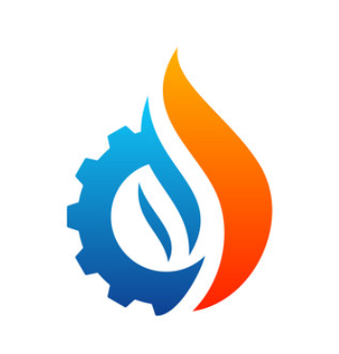
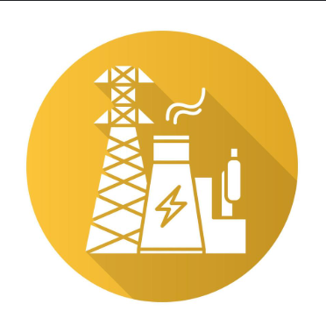
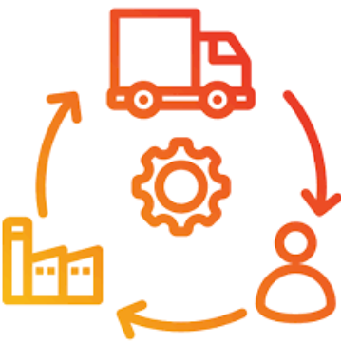
Solution Strategy: Features Inherited for SensorBuddy
ML Modeling
Features implemented through our Agentic AI Solution:
Advance Analytics & Reporting
Objective: Implement ML to predict sensor failures and detect anomalies in sensor data.
Data Collection & Preprocessing: Source data from DynamoDB, clean, normalize, and label it.
Model Training & Evaluation: Trained the XGBoost & other advance methods with cross-validation, achieving high accuracy and recall.
Deployment & Integration: Conduct real-time analysis using AWS Lambda, integrating with DynamoDB and Bedrock.
Future Enhancements: Improve predictions with other suitable & advancement and automate maintenance actions.
Anomaly Detection: Spot unusual patterns in real-time data.
Recommendation Engine: Recommend best maintenance schedules and adjustments.
Workflow Automation: Automate alerts for necessary follow-up actions.
Continuous Learning: Update prediction models with new insights.
Risk Assessment: Provide risk evaluations & mitigation suggestions
Conversational Interface: Facilitate operator interaction via text.
Automated Alerts & Notification
Integration with Microsoft teams
Real-time Reporting & KPI Analysis
Historical Trends & Forecasting
Target Businesses
Manufacturing Plants
Oil & Gas Industry
Energy Sector
Supply Chain
Notes:
we delve into the features of our Agentic AI Solution & cheri-picked the key features from each span of legacy ML modeling ,Gen AI and advance analytics to meet the end-to end solutioning for SensorBuddy, specifically targeting industries like manufacturing, oil and gas, and energy.
The solution includes automated alerts, real-time reporting, and a conversational interface for operator interaction. By implementing advanced analytics, we aim to provide businesses with the tools they need for effective maintenance and support management, ensuring they can respond swiftly to any issues that arise.
______

Slide 6
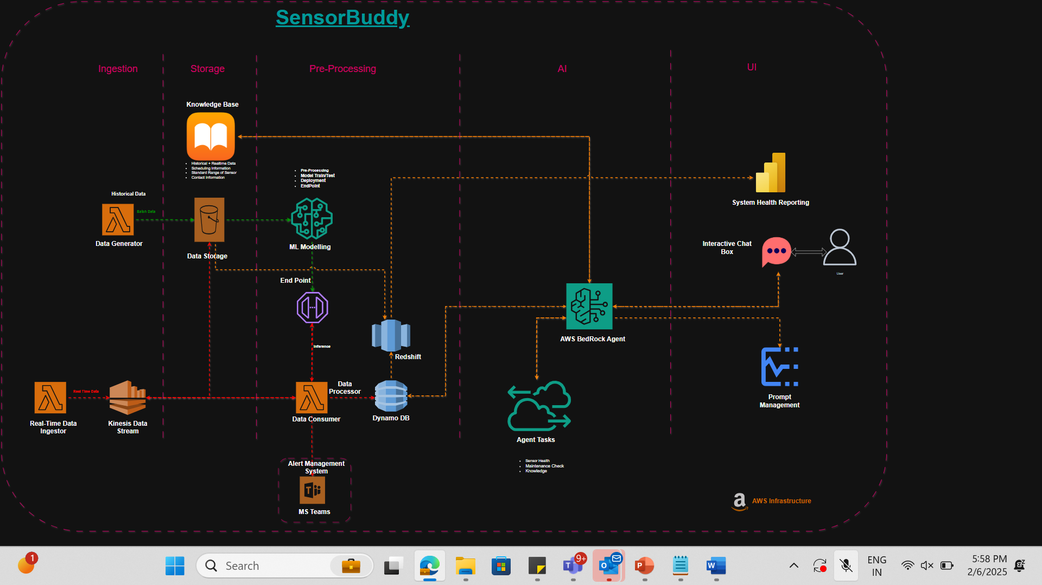
Technical Workflow
Notes:
Generated by Copilot
The Technical Workflow slide illustrates the comprehensive data processing and machine learning workflow we employ. It encompasses various stages, from data ingestion to user interaction, highlighting the integration of AWS services. This structured approach ensures that we can efficiently manage real-time data and provide actionable insights, ultimately enhancing the performance and reliability of our AI solutions.

Slide 7
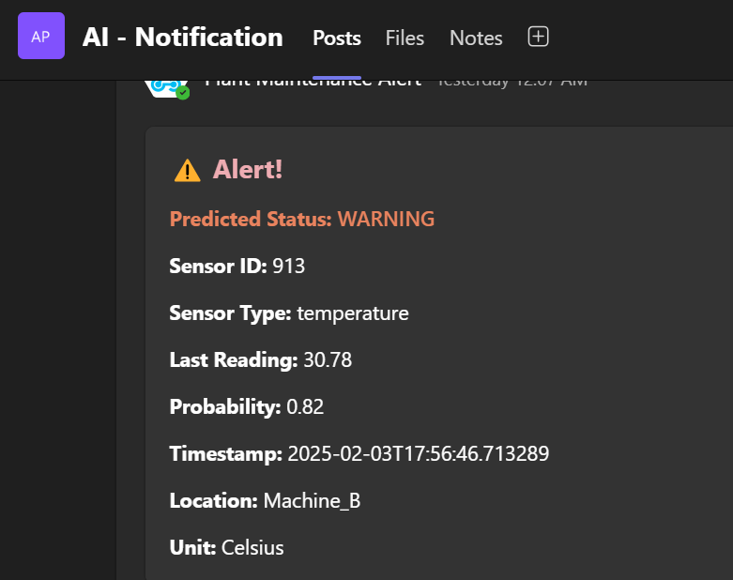
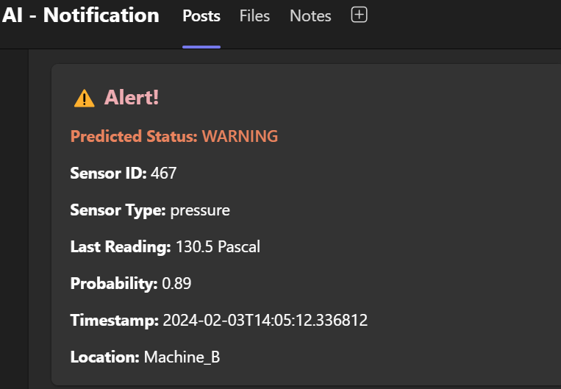
Automated Alerts and Integration with MS teams
Notes:
Generated by Copilot
This slide showcases the integration of automated alerts with Microsoft Teams, enhancing communication and responsiveness. The screenshots illustrate how users can receive detailed notifications about sensor statuses, including critical information like sensor ID and last readings. This integration is vital for ensuring that maintenance teams are promptly informed of any issues, allowing for swift action to mitigate risks.

Slide 8
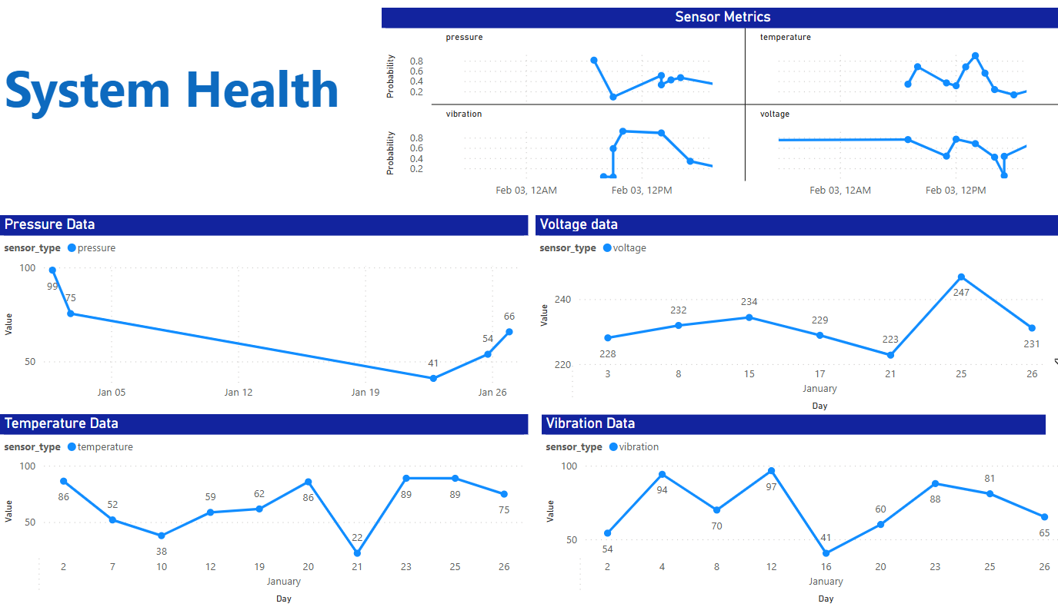
Illustration of Integrated KPI analysis & Visualization
Notes:
Generated by Copilot
Here, we present an integrated KPI analysis and visualization of sensor metrics. The line graph and sub-graphs provide a clear view of system health over time, allowing for quick identification of trends and anomalies. This comprehensive overview is essential for monitoring performance and making informed decisions regarding maintenance and operational strategies.

Slide 9

Live Demonstration of the AI agent “SensorBuddy”
Notes:
Generated by Copilot
This slide sets the stage for a live demonstration of our AI agent, SensorBuddy. The futuristic cityscape background emphasizes the innovative nature of our technology. During the demonstration, we will showcase how SensorBuddy operates in real-time, providing insights and recommendations that can significantly enhance maintenance processes and operational efficiency.
______
In this slide, we will present an interactive demonstration of our AI agent, SensorBuddy, showcasing its real-time predictive maintenance capabilities. Attendees will see how the system interacts with users, processes live data feeds, and provides actionable insights. User feedback will be collected during the demo to enhance future iterations of the solution.

Slide 10




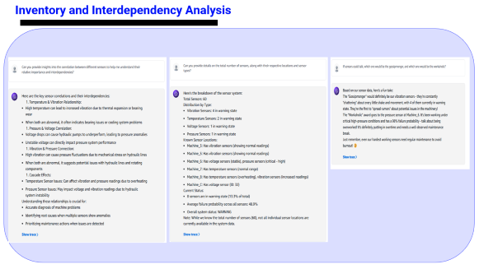
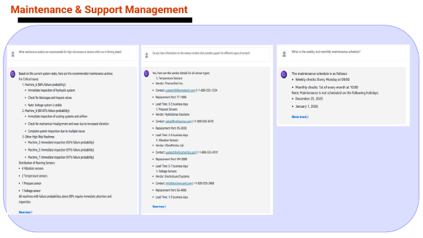
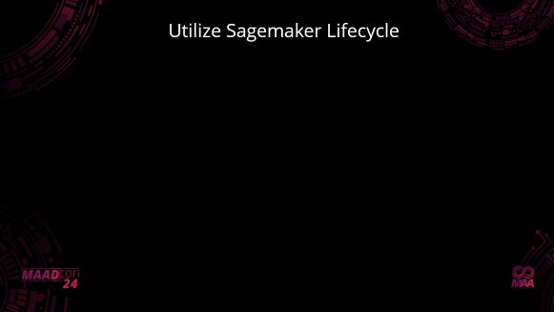
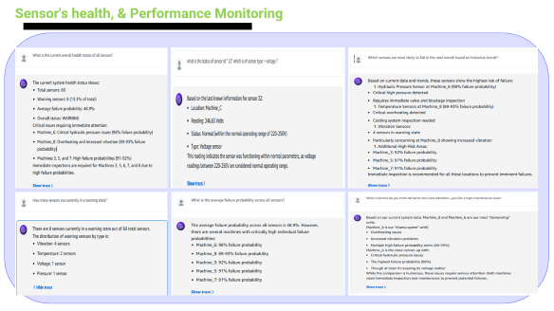
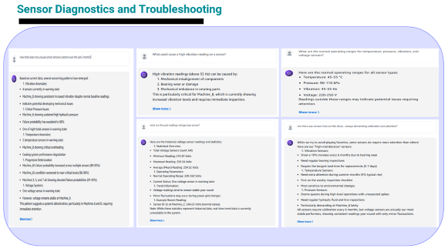
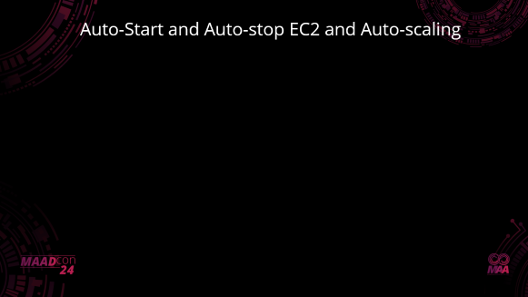
Illustration of real-time Prompt & Interactions
System Health and Performance Monitoring
Diagnostics and Troubleshooting
80%
Maintenance & Support Management
Inventory and Interdependency Analysis
50%
40%
Notes:
In this slide, we illustrate the real-time prompts and interactions facilitated by our AI solution. Each key area, such as system health monitoring and diagnostics, is represented visually, emphasizing the interactive nature of our technology. This approach not only enhances user engagement but also ensures that critical information is readily accessible for timely decision-making.
______

Slide 11
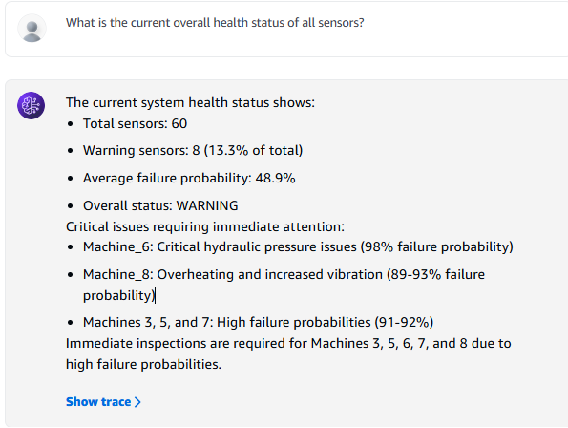
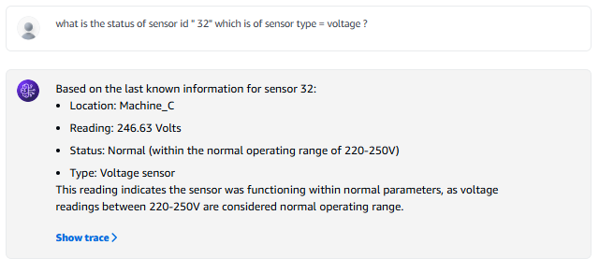
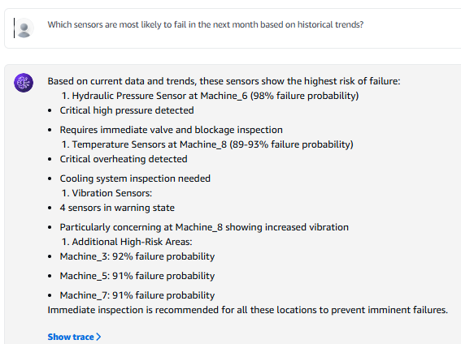
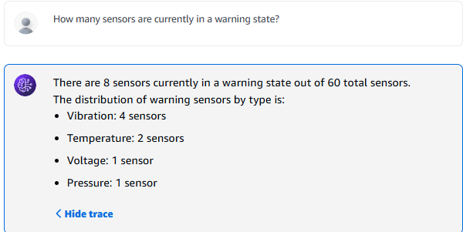
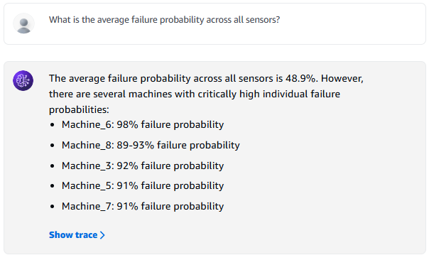
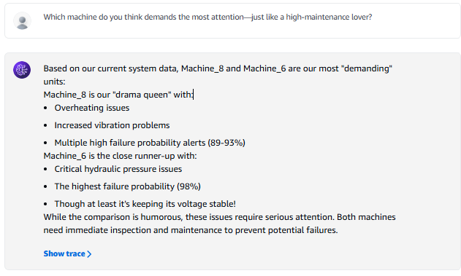
Sensor's health, & Performance Monitoring
Notes:
Generated by Copilot
This slide provides an in-depth look at sensor health and performance monitoring. It includes critical data on sensor status, warnings, and failure probabilities, enabling proactive maintenance strategies. By identifying sensors that require immediate attention, we can prevent potential failures and ensure optimal system performance, which is essential for operational reliability.
______

Slide 12
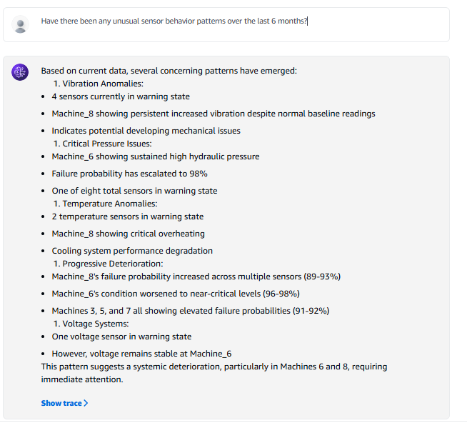
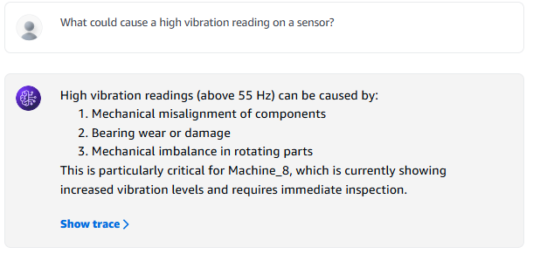
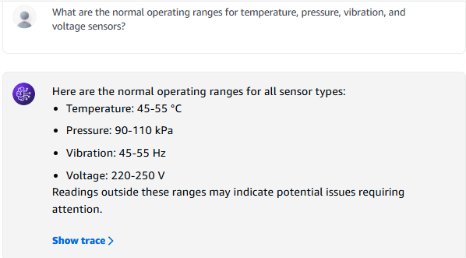
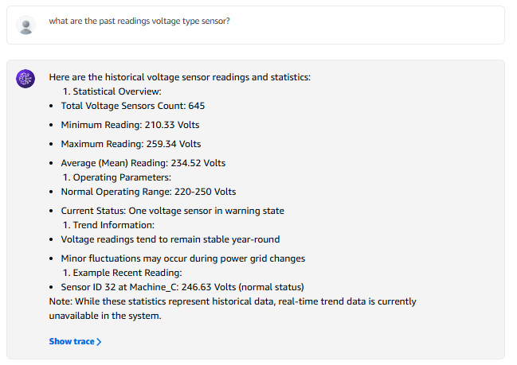
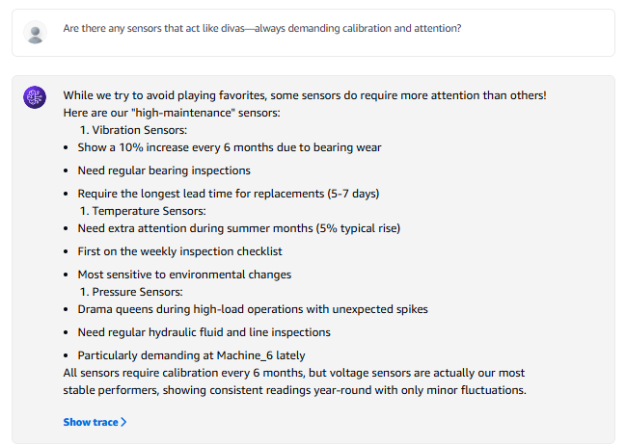
Sensor Diagnostics and Troubleshooting
Notes:
Generated by Copilot
Here, we analyze sensor diagnostics and troubleshooting practices. The detailed sections address common issues, such as unusual behavior and high vibration readings, providing insights into their causes. This thorough examination is vital for developing effective maintenance strategies and ensuring that all sensors operate within their normal ranges, ultimately enhancing system reliability.
______

Slide 13
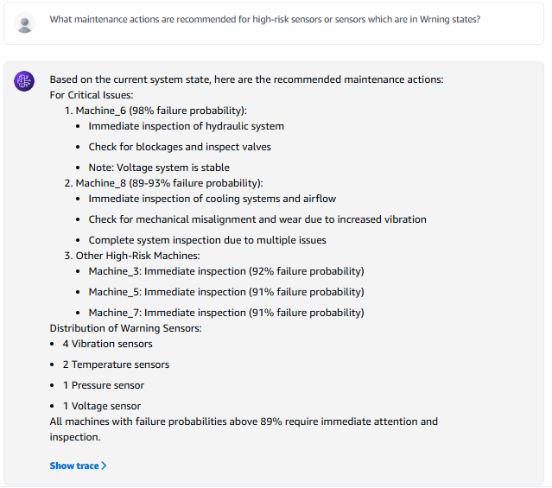
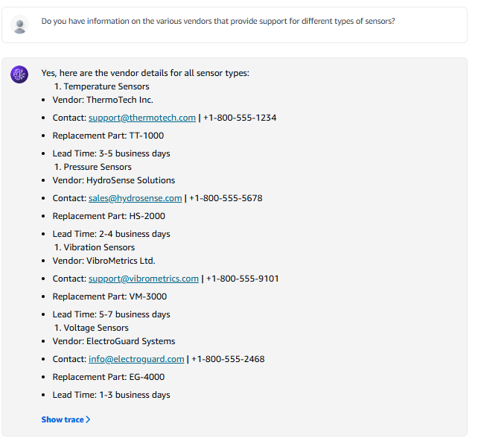
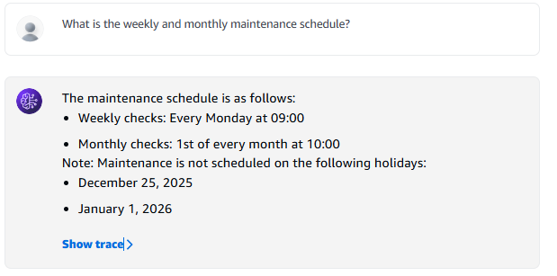
Maintenance & Support Management
Notes:
Generated by Copilot
This slide focuses on maintenance and support management, detailing recommended actions for high-risk sensors. By providing vendor information and outlining maintenance schedules, we ensure that teams are well-equipped to address critical issues promptly. This structured approach to maintenance management is essential for minimizing downtime and maintaining operational efficiency.
______

Slide 14
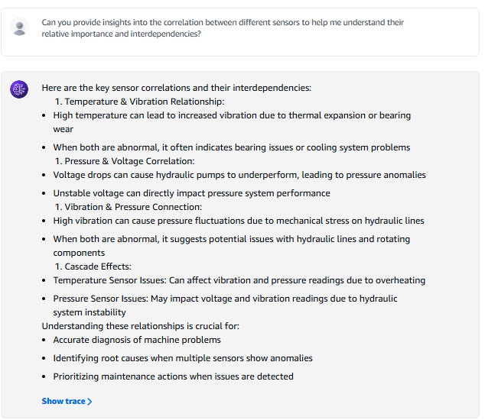
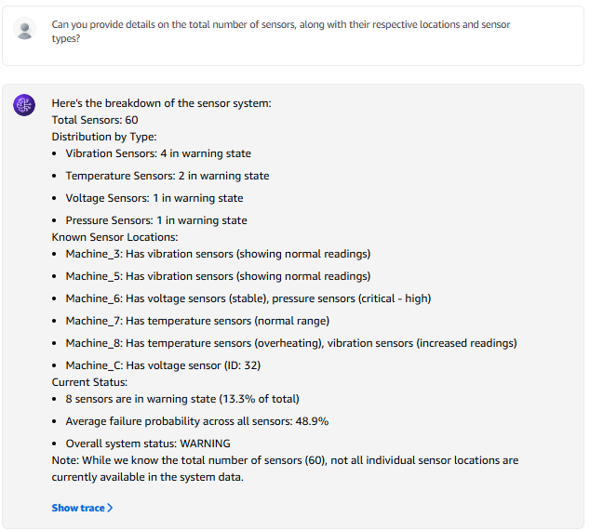
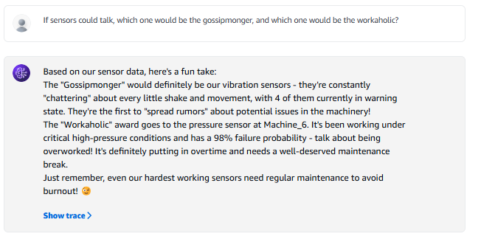
Inventory and Interdependency Analysis
Notes:
Generated by Copilot
In this slide, we explore inventory and interdependency analysis among sensors. Understanding the relationships between different sensors is crucial for effective monitoring and maintenance. By analyzing correlations, we can identify potential cascading effects and ensure that all components of the system work harmoniously, enhancing overall performance and reliability.
______

Slide 15
Next Steps & Future Scope
Features implemented through Agentic AI Solution:
Enhance Integration scope with enterprise applications
Explore advance features of AWS bedrock AI services like images
Engage & collaborate with interested businesses for tailored MVPs and implementation in real case
Implement Business Feedbacks for continuous learning and improvement
Use Human-in-Loop strategy & re-enforcement learning to finetune AI Agent from Predictive suggestion to action
Target Businesses
Manufacturing Plants
Oil & Gas Industry
Energy Sector
Supply Chain
Notes:
Here we outline the features implemented through our Agentic AI Solution, focusing on the next steps and future scope. We aim to enhance AI capabilities, improve integration with enterprise applications, and explore advanced features of AWS services. Engaging with businesses for tailored MVPs will be crucial for continuous improvement and ensuring our solutions meet industry needs effectively.

Slide 16
Thank you !
Time for Q& A!!
Notes:
Generated by Copilot
As we conclude, I want to express our gratitude for your attention. This slide invites questions and discussions, emphasizing our openness to feedback and collaboration. Engaging with you during the Q&A session will allow us to address any inquiries and further elaborate on our innovative solutions and their potential impact.
______
We encourage user interaction during the demo, and we will gather feedback to understand how well our solution meets user needs and expectations.

